Slide 1


DETECTION OF STATISTICAL ARBITRAGE USING MACHINE LEARNING TECHNIQUES IN NYSE:AI STOCKS
BY: Jeanel Mouelle, Herve Kivuvu, Amani Nixon

Slide 2


PROJECT OVERVIEW:
The goal of this project is to deploy machine learning models to detect statistical arbitrage opportunities in the New York Stock Exchange (NYSE). By leveraging machine learning techniques, we aim to identify patterns and signals that can indicate potential arbitrage opportunities in NYSE-listed stocks. We will utilize regression and time delay neural network techniques for our analysis.

Slide 3


DATASET & SOURCECODE
Data obtained from the NASDAQ Historical Data section.
Source code for neural network obtained from Matlab Neural Network Toolbox

Slide 4

PROJECT PHASES:
Pick an Asset: NVDA
Component stock: SMCI
Historical Data API: 2015-2024: use their daily returns
Develop a trading algorithm based on multiple regression models

Slide 5
Split Data : data training, validation, and testing sets. The training set is used to train the model, the validation set is used for *hyperparameter tuning, and the testing set is used to evaluate the model's performance

Slide 6
WHAT IS STATISTICAL ARBITRAGE?
Statistical arbitrage refers to attempting to profit from pricing inefficiencies identified through mathematical models. For example if a pair of shoes sells for $200 in Minnesota and for $400 in New York, one could buy the doll in Minnesota and sell it in New York for a profit of $200. Such a situation occurs in the market because information about prices takes time to travel from one place to another.

Slide 7

PROCEDURE
Analysis of AI Computer sector stocks using regression to model an index.
Assessment of the index's correlation with the target stock (NVIDIA Corp).
Prediction of market price based on historical data.

Slide 8
Time series modeling using historical stock prices.
Utilization of Nonlinear Auto Regressive Neural Network (NAR) for prediction.
Training algorithm: Levenberg-Marquardt backpropagation.
Evaluation of prediction accuracy for different network structures and time
delays.
PREDICTION USING NEURAL NETWORKS:

Slide 9
DATA ANALYSIS
LSTM Neural Network
Pairs Trading Model
Long Short-Term Memory (LSTM) is a type of recurrent neural network (RNN) architecture that is particularly effective in learning and predicting sequences of data
Pairs trading is a quantitative trading strategy that seeks to exploit the historical correlation between two assets by taking simultaneous long and short positions in them.
SVR Model
Logistic Regression
Support Vector Regression (SVR) is a powerful machine learning algorithm used for regression tasks.
Logistic regression is a type of statistical model used for binary classification tasks, where the target variable has two possible outcomes.

Slide 10
DATA ANALYSIS
Mutivariate OLS FORECAST
Long Short-Term Memory (LSTM) is a type of recurrent neural network (RNN) architecture that is particularly effective in learning and predicting sequences of data
OLS MODEL
Support Vector Regression (SVR) is a powerful machine learning algorithm used for regression tasks.

Slide 11
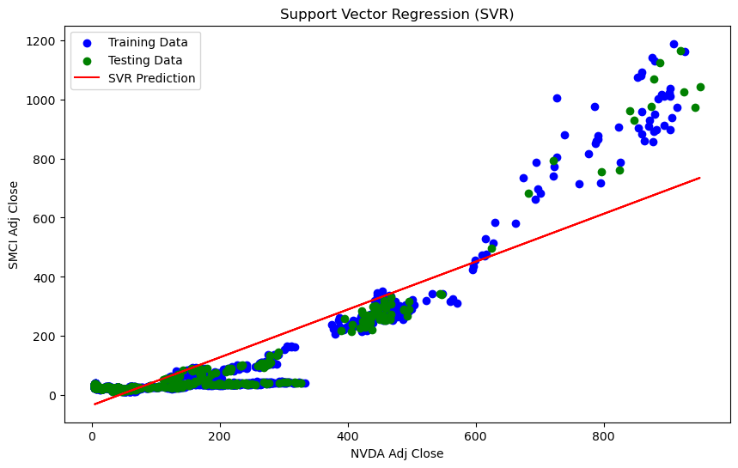

Slide 12
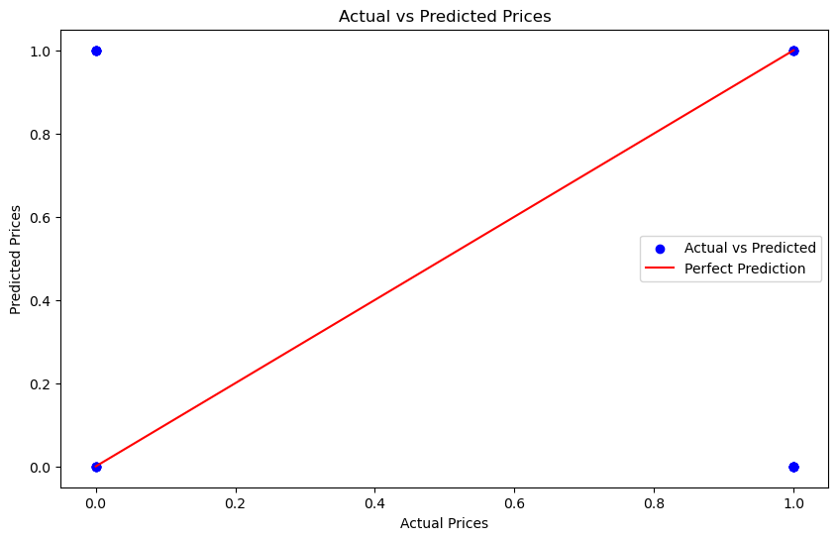

Slide 13
Value-at-Risk (VaR)
Accuracy: 0.75
Precision: 0.5
Recall: 0.8
F1-score: 0.6153846153846154
AUC-ROC: 0.7666666666666667
LOGISTICAL
REGRESSION
MODEL

Slide 14
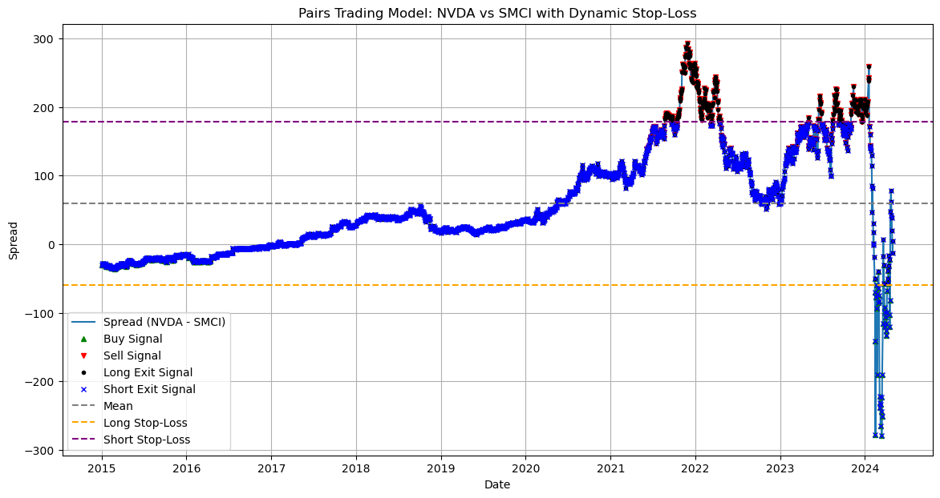

Slide 15
Entry and Exit Signals:
Correlation between NVDA and SMCI: 0.8854405177233349
Pairs trading strategies often use threshold-based rules to generate entry and exit signals.
PAIRS TRADING

Slide 16
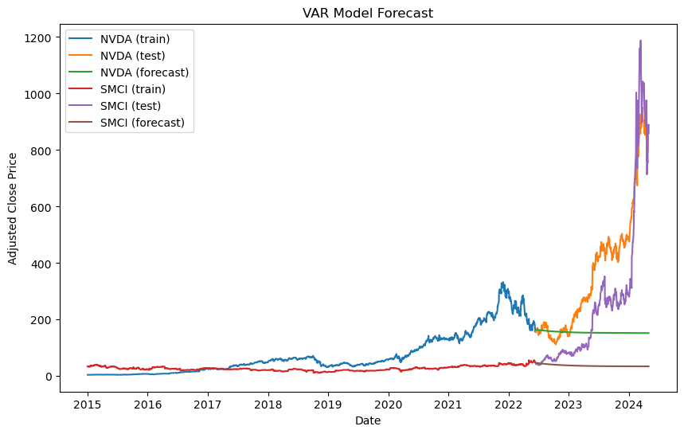

Slide 17
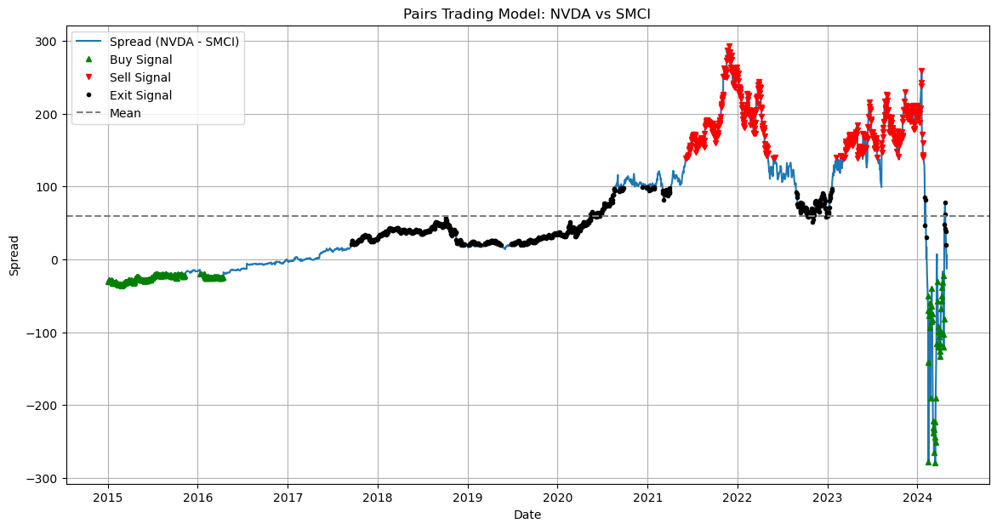

Slide 18
PITTFALLS
Value-at-Risk (VaR)
The evaluation of certain quantities such as Value-at-Risk is “backtested”, whereby historical data for a time period is a trained generative model, at which point the true VaR observed in the subsequent historical period is compared with that obtained by the generative model.
This method suffers from a dearth of data since there is only one history.

Slide 19
CALCULATE ACTUAL SPREAD IN PAIRS TRADING MODEL
Mean Absolute Error (MAE): 6.725516122208055

Slide 20
POTENTIAL OF STATISTICAL ARBITRAGE:
Statistical arbitrage is not strictly limited to two securities. Investors can apply the concept to a group of correlated securities. Also an investor is not limited to a specific industry of stock.

Slide 21
FUTURE WORK
In the future to further complete and perfect this project we will increase the level of accuracy between the target and component stock. As well as add more component stocks: MFST, GOOGL, META, AMD, MRVL, AVGO, ANET, ALAB, AAPL, AMZN, PLTR, INTC, SOUN

Slide 22
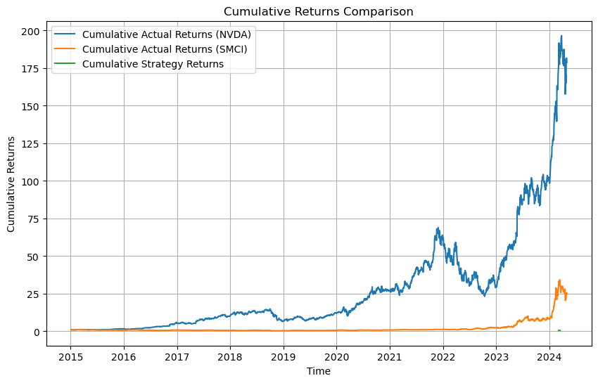

Slide 23
THANK YOU!

Slide 24



Resource
Page:https://www.macrotrends.net/stocks/research https://www.nasdaq.com/market-activity/quotes/historical https://www.mathworks.com/help/stats/neural-networks-for-classification.html

